Slide 1
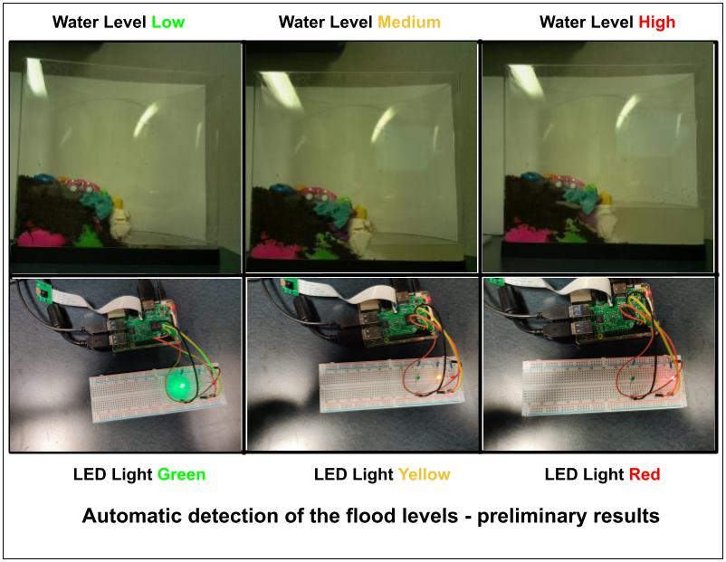

Flood Detection using Raspberry Pi
Presented By,
Mohammed Nauman Siddique
Department of Computer Science
OLD Dominion University
Spring 2021
2021-04-05

Slide 2
Timeline of Historical Flooding in Norfolk
1978
Nor'Easter
1998–1999
Hurricanes Bonnie and Floyd
2003
Hurricane Isabel
2006
Hurricane Ernesto
2009
Nor'easter Nor'Ida
2011
Hurricane Irene
2016
Hurricane Matthew
Reference: https://data.norfolk.gov/stories/s/FEMA-National-Flood-Insurance-Program-Redacted-Cla/gi5t-nkzw/

Slide 3
Introduction for the Project
Measure flooding levels using the Raspberry PI board and alert users by turning on the LEDs.

Slide 4
LED Lights Interpretation
LED Light | Water Level | Threat Level
Green | Low | Safe
Yellow | Medium | Alert
Red | High | Danger

Slide 5
Results from the Project

Slide 6
Equipment for the project
Fish Tank
Raspberry Pi Kit (3 or 4)
Raspberry Pi Camera
Bread Board
Three LED Lights (Red, Yellow, and Green)
Resistors (Minimum 3)
Jumper Wires

Slide 7
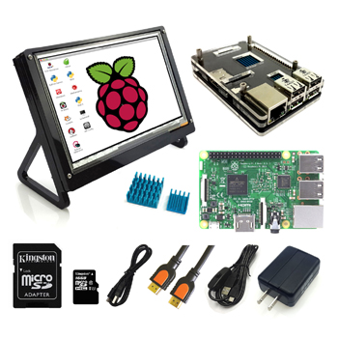
Raspberry Pi Kit
Screen
Pi Case
Taken from: http://www.eleduino.com/Raspberry-Pi-3-Super-Integrated-Computer-Kit-p10572.html
Pi Board
Heat Sink
(Optional)
SD Card and
SD Card Reader (optional)
HDMI
Power Adapter and cable

Slide 8
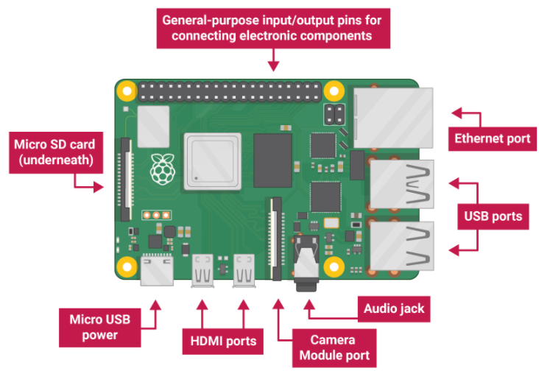
Raspberry Pi
Taken from: https://projects.raspberrypi.org/en/projects/raspberry-pi-getting-started/2

Slide 9
How to power up your Pi board?
Insert SD Card into your Pi Board
Connect Pi Board to a monitor screen using HDMI Cable
Connect Mouse and Keyboard to the USB Ports
Power Up your Pi board

Slide 10
Connect Pi Board to Internet
Connecting Pi Board to Wi-Fi using User Interface https://www.raspberrypi.org/documentation/configuration/wireless/desktop.md
Connecting Pi Board to Wi-Fi using CLI https://www.raspberrypi.org/documentation/configuration/wireless/wireless-cli.md
Connect Pi Board to LAN using Ethernet Port https://raspberrypi.stackexchange.com/questions/11684/how-can-i-connect-my-pi-directly-to-my-pc-and-share-the-internet-connection

Slide 11
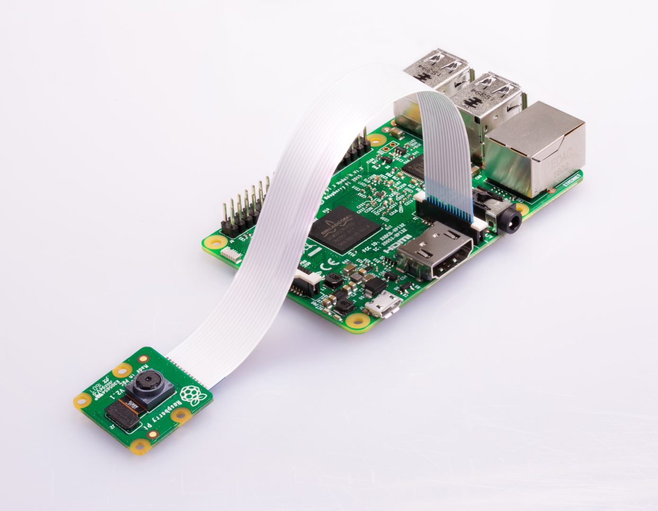
Pi Camera
Taken from: https://projects.raspberrypi.org/en/projects/getting-started-with-picamera

Slide 12
How to connect Pi Camera to Pi Board
Power Off your Pi Board
Find the camera port on the Pi Board
Pull up the camera port plastic clip
Insert the Pi Camera ribbon and make sure the cable was inserted in the correct manner
Push the plastic clip back into place
Power Up your Pi Board

Slide 13
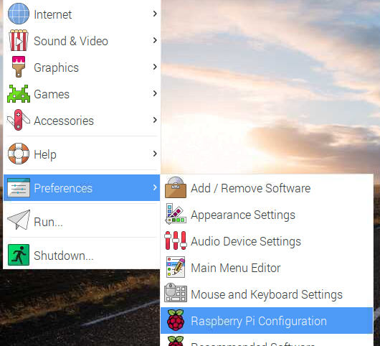
Main Menu -> Raspberry Pi Configuration

Slide 14
Interfaces -> Camera (Enabled)

Slide 15
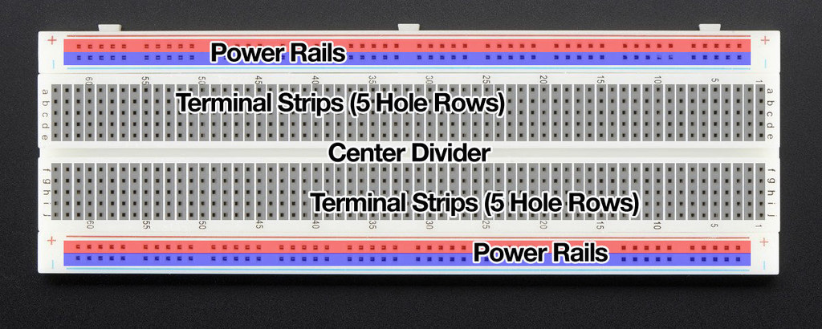
Bread Board
Taken from: https://learn.adafruit.com/breadboards-for-beginners?view=all

Slide 16
Components for using a breadboard
Breadboard
LED lights (Red, Yellow, and Green)
Resistor (Atleast three)
Male-to-female jumper leads
Male-to-male jumper leads

Slide 17
Connect LEDs using Breadboard to Pi Board
Power off the Pi Board
Connect a jumper wire from GPIO pins and breadboard voltage rail
Connect a jumper wires from GPIO pins and breadboard ground rail
Connect the LED to a terminal strip
Connect a resistor between voltage rail and LED terminal strip, if the LED strip is 5 connect resistor between terminal strip 5 and voltage rail
Connect a resistor between ground rail and LED terminal strip, if the LED strip is 5 connect resistor between terminal strip 5 and ground rail
Connect other LEDs by repeating the steps 2, 4, and 5.
Reference and further read: https://magpi.raspberrypi.org/articles/breadboard-tutorial

Slide 18
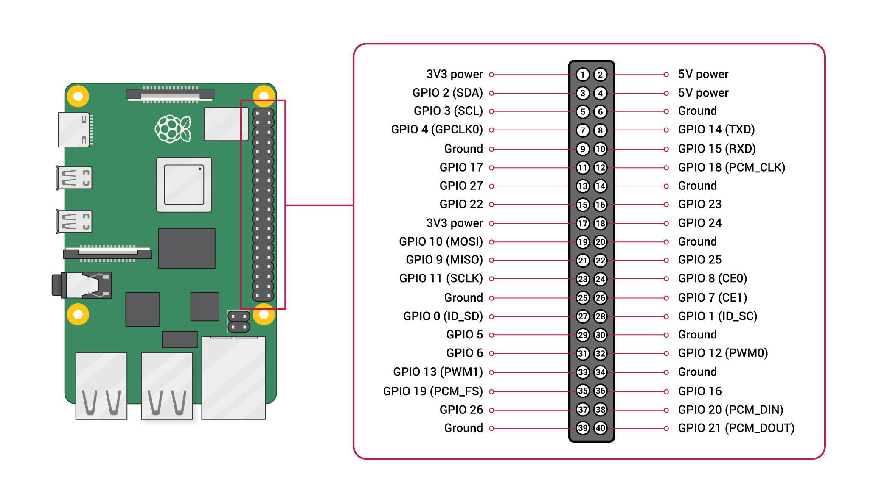
Raspberry PI GPIO Pins
Reference: https://www.raspberrypi.org/documentation/usage/gpio/

Slide 19
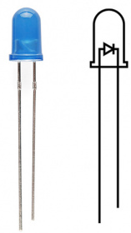
LEDs and its connection on breadboard
Connect the Positive Side to the voltage rail of the breadboard
Connect the Negative Side to the ground rail of the breadboard
Positive Side (Anode)
Negative Side (Cathode)
Reference: https://learn.sparkfun.com/tutorials/light-emitting-diodes-leds/all

Slide 20
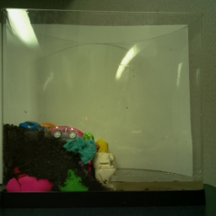
Fish Tank Model
White Background
Land
Water

Slide 21
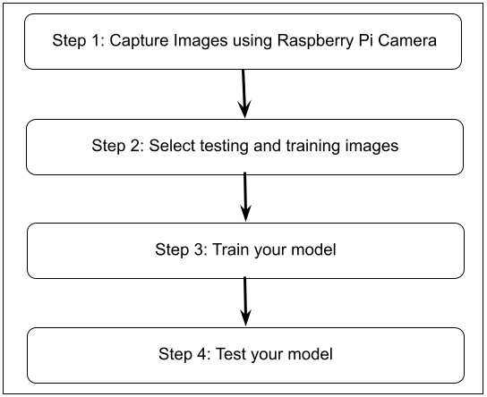
Flood Detection Model Architecture

Slide 22
Assumptions of the Project
capture 256 * 256 pixel images
project simulated on a fish tank
Use white background for the fish tank to avoid grey scale image conversion issues
captured images must capture the entire fish tank
more than 90% of the image must be the fish tank to reduce the surrounding noise for better results

Slide 23
Code Snippet for capturing Images
camera = picamera.PiCamera() # Setup a Picamera Object
camera.resolution = (256, 256) #Capture 256*256 resolution images
camera.start_preview() # Open Camera Preview
time.sleep(2) # Freeze the preview for 2 seconds
camera.capture(os.path.join(os.getcwd(), "images", "testing", imageName)) # Capture images and write to a file location

Slide 24
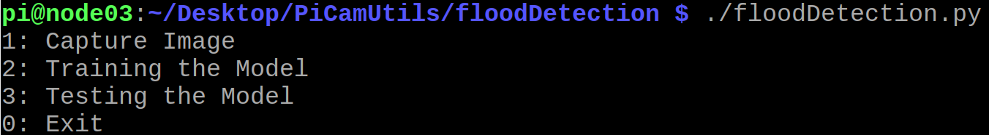
Menu of the Program

Slide 25
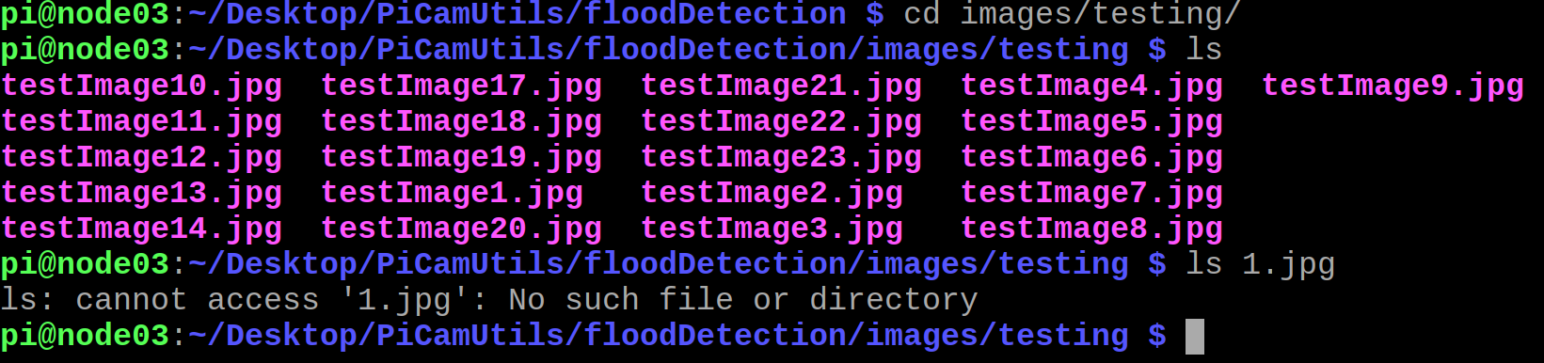
1.jpg file is not present

Slide 26
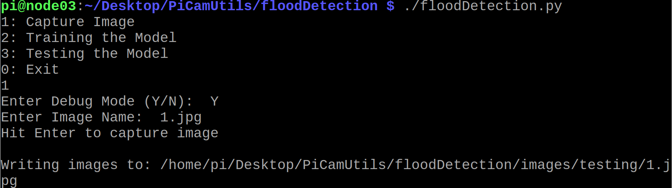
Capture Image using Option 1

Slide 27
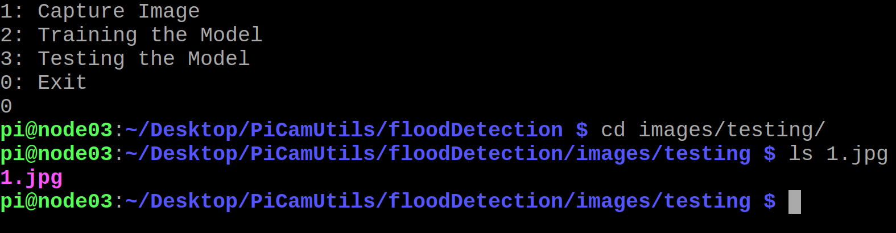
Validate 1.jpg file

Slide 28
Captured 21 testing images
We captured 21 training images using Option 1.
Full List of images: https://github.com/isaki001/PiCamUtils/tree/master/floodDetection

Slide 29
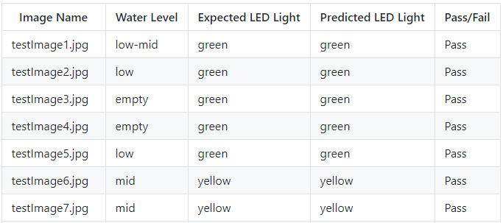
Truth set of captured images Available at: https://github.com/isaki001/PiCamUtils/tree/master/floodDetection

Slide 30
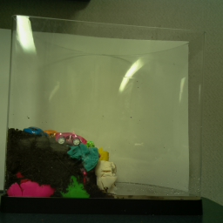
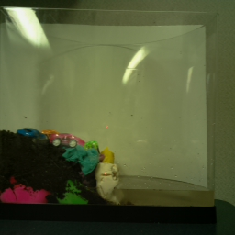
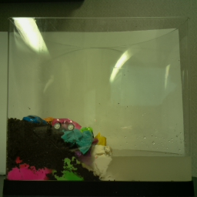
Training the model (Select three images, one for low, one for medium, and one for high water level)
Water Level Low
Water Level Medium
Water Level High

Slide 31
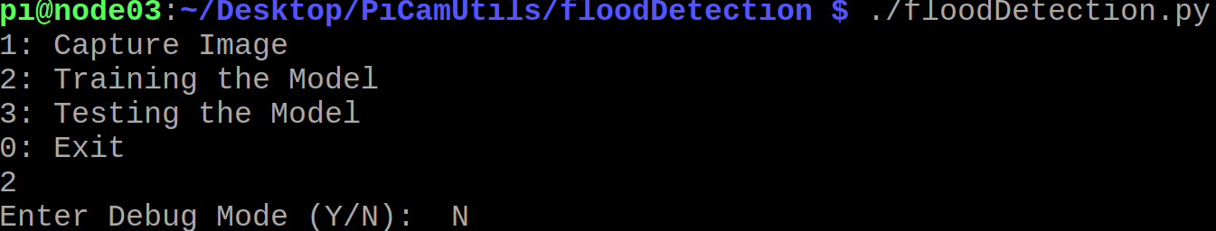
Train the model using option 2

Slide 32
Greyscale Images and its usage in our project
Greyscale images are those images whose each pixel stores the shades of grey.
Advantage: Converting a RGB image requires less space for storing image pixel values in greyscale images
Usage in our project
For our project, we convert each image to a greyscale scale image using a threshold value. The pixel values in the image above the threshold is set to 255 while the pixel values below the threshold is set to 0.
The greyscale threshold values covert all the color pixels to 255 and all the white pixel to 0.

Slide 33
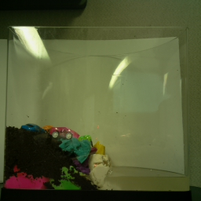

Basic about Greyscale Images and Pixel Values
0
255
Image Height
in Pixels
0
255
0
Image Width
in Pixels
255

Slide 34
Use the image to find pixel values of fish tank, land level, and water level
Step 1: Select a 256*256 image
Step 2: Convert it to Greyscale Image
Step 3: Find the fish tank top and bottom pixel values: tankTop and tankBottom
Step 4: Find the water level pixel value : waterLevel
Step 5: Find the highest point on the land pixel value : landLevel
Step 6: Compute scaling ratio (Tank Height / 255), since 255 is the height of image in pixel value
Tank Height = (tankTop – tankBottom)
Scaling Ratio = Tank Height / 255

Slide 35
Computation of Fish Tank Pixel Values
0
tankTop
tankWidth
Image Height
in Pixels
landLevel
waterLevel
tankBottom
255

Slide 36
Explanation of Fish Tank Values
tankTop is the pixel value of the first white pixel value encountered in the image.
tankBottom is the pixel value of the last white pixel value encountered in the image.
tankWidth is the maximum difference of pixel values between the first and last white pixel value encountered in the image on the horizontal scale.
landLevel is the pixel value where the black pixel value covers less than 80% of the fish tank and its pixel value is greater than tankTop.
waterLevel is the pixel value where the second half (tank split vertically) of the fish tank’s black pixel value covers between 30% and 43% of the fish tank.

Slide 37
Compute flood detection parameter values
Step 7: Compute Water Level Height
Water Height = (tankBottom - waterLevel) / Tank Height
Step 8: Compute Land and Water Height Difference
Land Height = (tankBottom - landLevel) / Tank Height
Height Difference = (Land Height – Water Height) / Tank Height
Step 9: Compute Water and Land Ratio
Water to Land Ratio = Water Height / Land Height

Slide 38
Computed Training Values
Water Level | Water Height | Height Difference | Water to Land Ratio
Low | 0.035 | 0.227 | 0.134
Medium | 0.071 | 0.188 | 0.273
High | 0.145 | 0.165 | 0.468

Slide 39
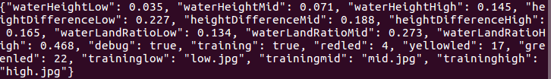
Write the training values to a serialized configuration object

Slide 40
Configuration File (Low and Medium Water Levels) - Part 1
[LOW] // Stores low water level values
WATER: -1 // Water Height
DIFFERENCE: -1 // Height Difference
RATIO: -1 // Water Land Ratio
[MID]
WATER: -1
DIFFERENCE: -1
RATIO: -1

Slide 41
Configuration File (Hight Water Level and LED Lights)
[HIGH]
WATER: 0.2
DIFFERENCE: 0.8
RATIO: -1
[LED] // Stores the Raspberry Pi GPIO Pin number for LED lights
RED: 4
YELLOW: 17
GREEN: 22

Slide 42
Configuration File (Training Images)
[TRAINING] // Stores the training image names
LOW: low.jpg
MID: mid.jpg
HIGH: high.jpg

Slide 43
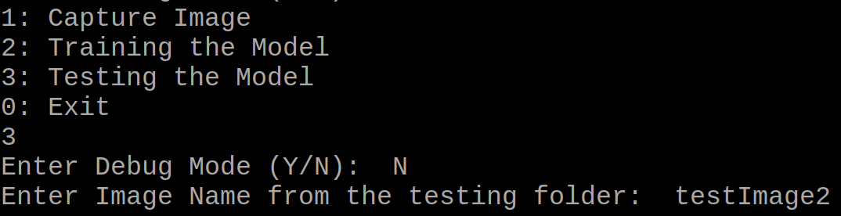
Train the model using option 3

Slide 44
Testing Steps
Step 1: Read the serialized Configuration object containing training values
Step 2: Compute Water Height, Height Difference, and Water to Land Ratio for the testing Image
Step 3: Compare the computed values against the training values of all the three parameters
Step 4: Each parameter returns a predicted water level
Step 5: Use the best of three water level as predicted water level
Water Height: Red Height Difference: Yellow, Water to Land Ratio: Red → Predict: Red
Water Height: Red Height Difference: Yellow, Water to Land Ratio: Green → Predict: Error

Slide 45
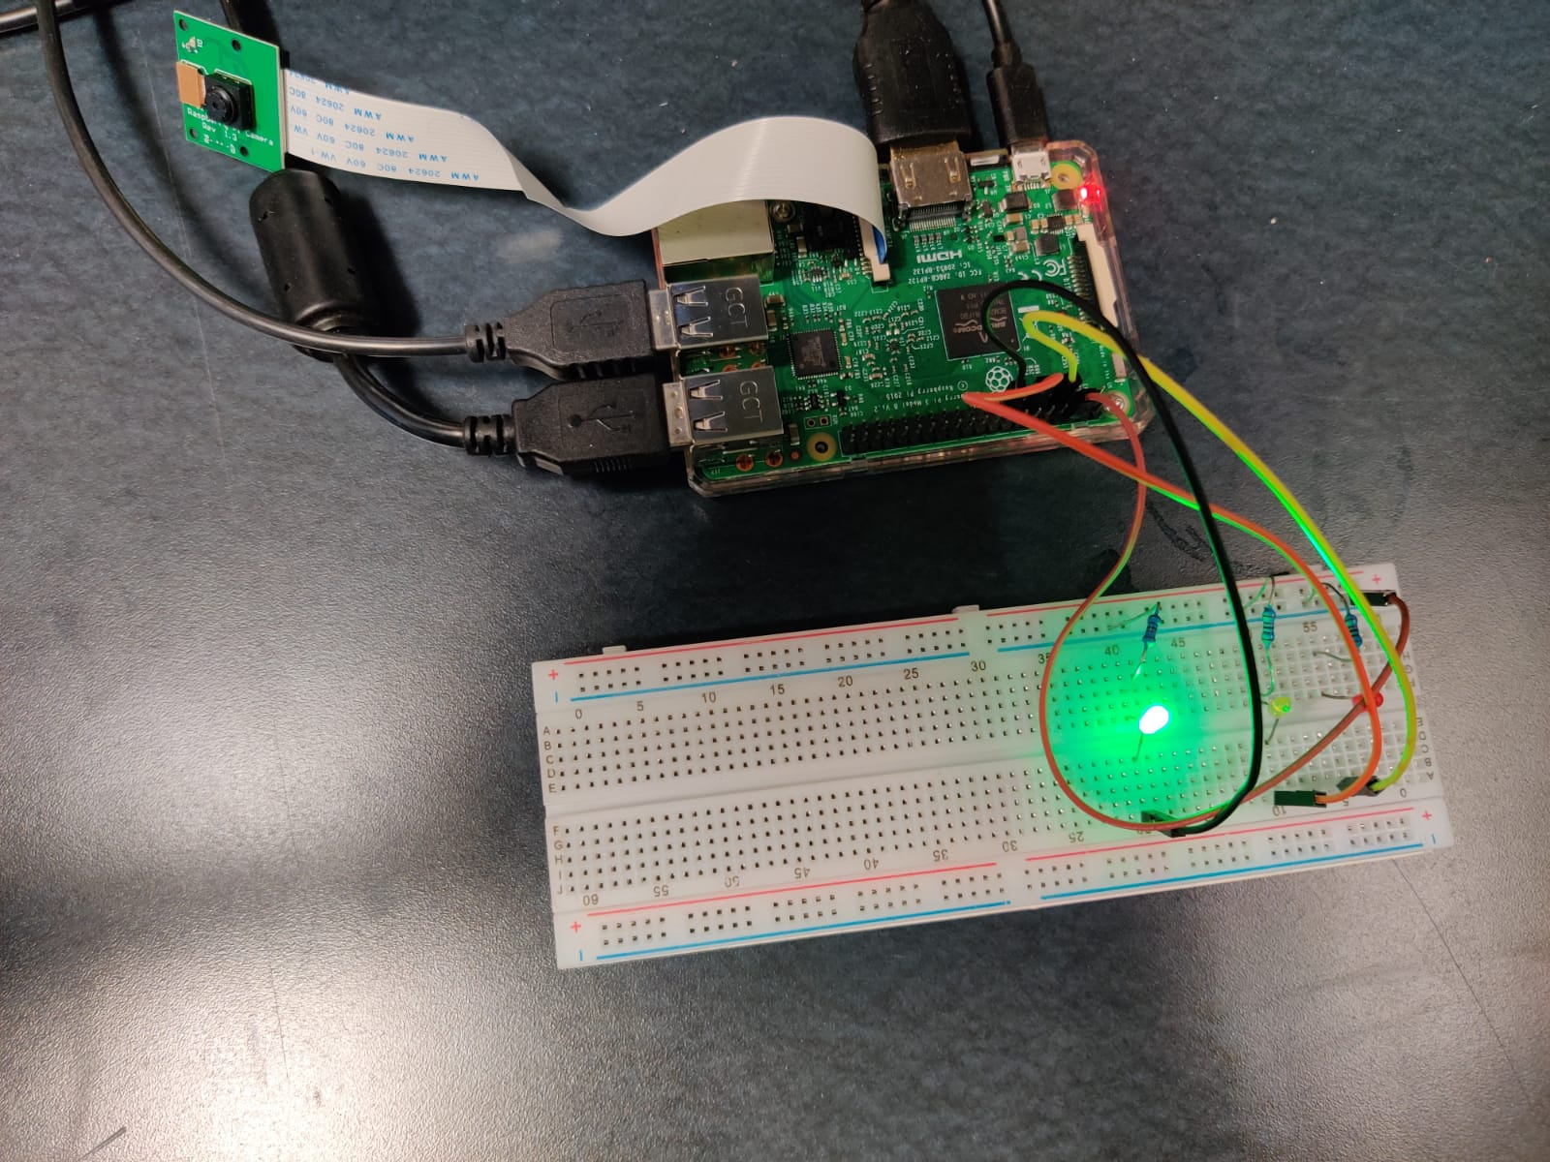
Testing Water Level Low

Slide 46
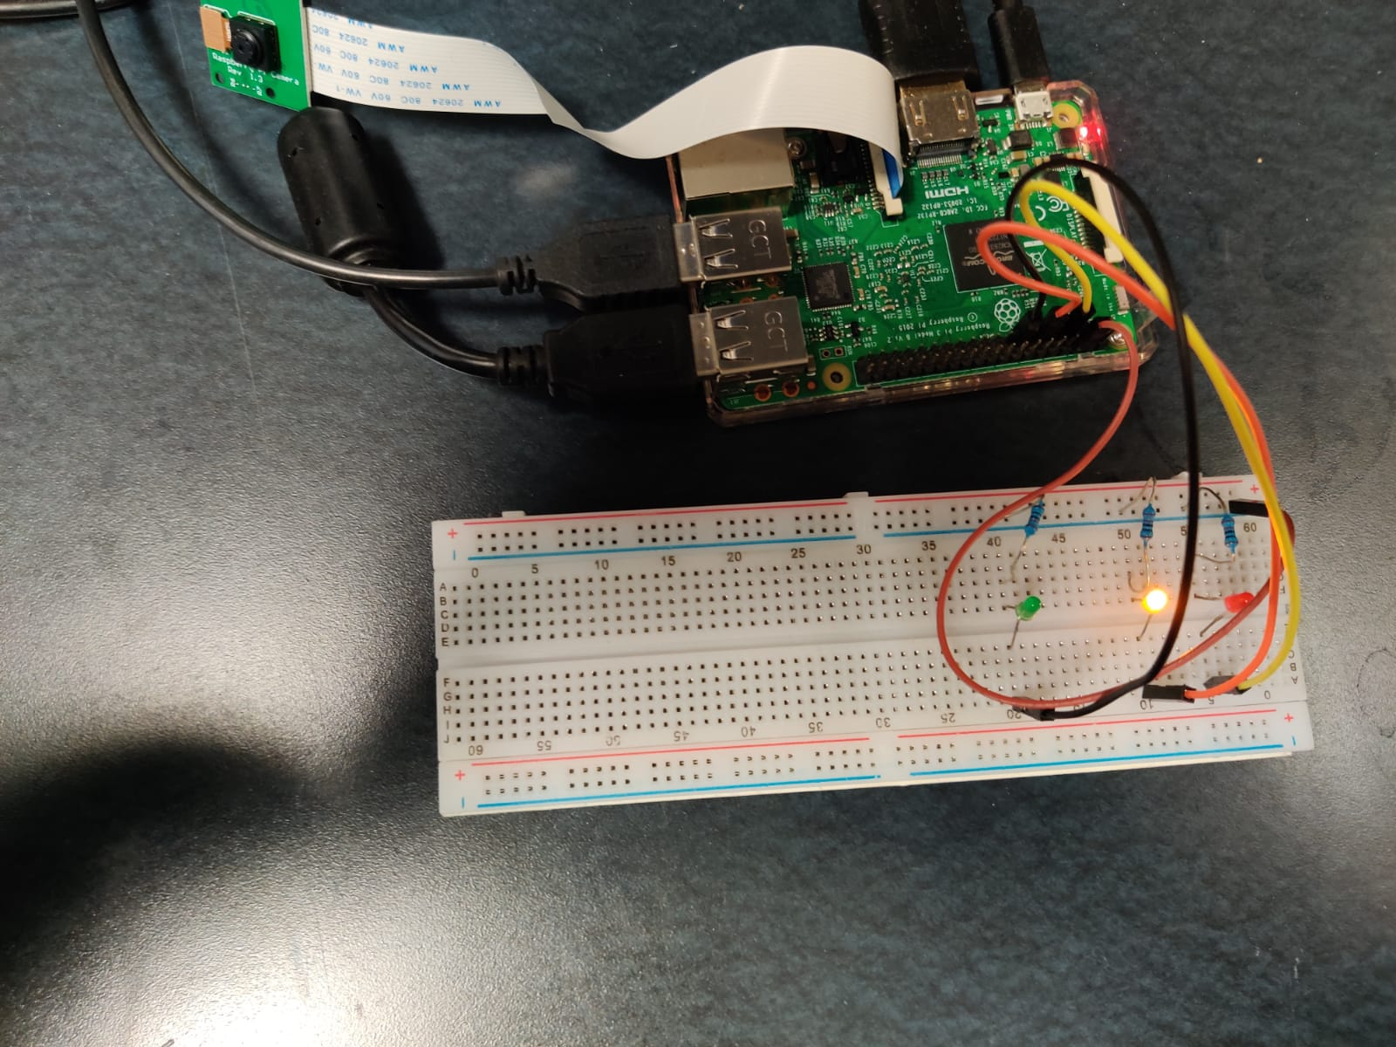
Water Level Medium

Slide 47
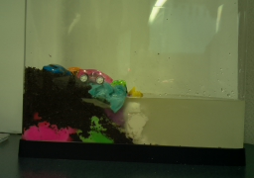
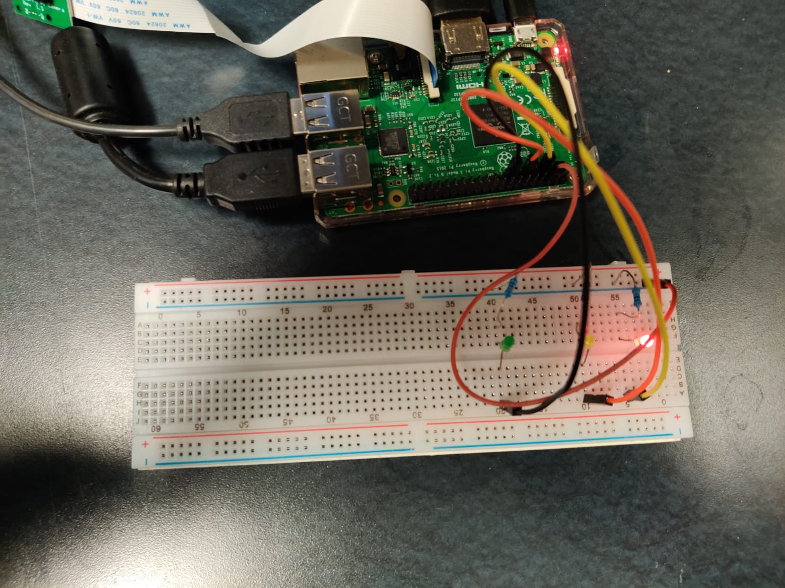
Testing Water Level High

Slide 48
Results of the Project
Of the 21 Testing Images only one image is predicted with wrong water level.
Our model predicts testImage14.jpg as water level high while the actual water level is medium.

Slide 49
Project Dependencies
Python3 (Programming Language)
picamera (library for capturing images using Raspberry Pi camera)
OpenCV (library for image processing)
gpiozero (library for using LEDs with Raspberry Pi)

Slide 50
Project Code Description
.
├── images
│ ├── testing # Testing Images
│ ├── training # Training Images
├── watertank.py # Code for measuring water tank level and turning the respective LED lights
├── configmanagement.py # Read and writing configuration files
├── configuration
│ ├── config.ini # Configuration file
│ ├── config # Serialized Config object

Slide 51
Code Available at: https://github.com/isaki001/PiCamUtils/tree/master/floodDetection

Slide 52
Conclusion
Project for measuring the flooding levels using Raspberry PI by comparing images and turn on the respective LED to alert the user.
Project completed with a flood detection simulation model using Raspberry Pi with approx. 95% accuracy.

